Slide 1

Club Overview - Today...
(Get Excited!!!!!)

Slide 2
Agenda
Opening
Basics of Programming
Closing

Slide 3
Opening

Slide 4
Basics of programming
We will learn some basic programming constructs. These are used in EVERY programming language.
Variables
Conditions
Loops
Functions
Operators

Slide 5
What is a Variable ?
It is a temporary name to store a value
They are like math variables.
They can store different kinds of values
String of Characters or words :
name = “Alice” or str = “girls who code”
Number : age = 12
Decimal : temperature = 55.6
Boolean : girl = true;

Slide 6
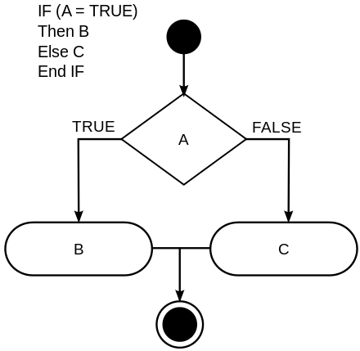
What is a Condition ?
If(girl==True)
Print(“She is a girl”)
Else
Print (“He is a boy”)
Else is optional !

Slide 7
What is a Loop ?
If you want to run code over and over again.
For eg Print “Hello World !” 5 times
Print(“Hello World !”)
Print(“Hello World !”)
Print(“Hello World !”)
Print(“Hello World !”)
Print(“Hello World !”)
Great ! Now Print it 2348 times!

Slide 8
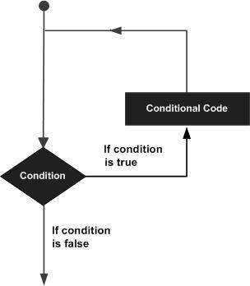
What is a Loop ?
count = 0
While (count < 2378)
Print(“Hello World !”)
count = count + 1

Slide 9
What is a Function ?
A named section of code that performs a specific task. It can accept variables and return results upon completion.
For eg, Function to return the multiplication of 2 numbers.
funMultiply(a,b)
result = a * b
return result

Slide 10
What is a Function ?
Using a function
a = 4 , b = 3
ans = funMultiply(a,b)
Print(ans) <- Also a function
We can also use actual values in place of a and b and we can call a function from a loop, if.. else or even another function !
Print(“The multiplication of 236 and 342 is “funMultiply(236,342))

Slide 11
What are Operators?
Assignment = a = 7
Addition , Subtraction + - result = 3 + 5 – 8
Multiplication, Division * / result = a*2, result = 8/2
Modulus % result = 8%2
Equality == , != if(a/2 == 4) print(“a is 8”)
Exponentiation ** result = a**2 finds square of a number
Comparison >, <, <= ,>= if(a<10) print(“a is single digit”)

Slide 12
Lets try some programs
Write a function to calculate area of a rectangle
rectangleArea(height,width)
area = height*width
return area
Print(rectangleArea(5,6))
30

Slide 13
Lets try some programs
Print Multiples of 5 until 50
a = 1
While(a <= 10)
Print (a*5)
5
10
15 …

Slide 14
Coding!

Slide 15
Coding!
When you have a question...
Spend 10 minutes on a given problem.
Check the instructions again!
Check if the module provides any hints!
Google the problem.
Ask someone else in the club.
Ask another person in the club.
Ask me for help!

Slide 16
Closing

